Slide 1
Research Seminar – Question Suggestion in Financial Institutions
St.Gallen, 11th March 2026

Slide 2
Proposed research question & hypotheses
Generic question (allocated)
Do demographics affect bank funding?
Specific question (to be defined)
Population Aging and Bank Deposit Funding: The Role of Financial System Structure
Hypotheses
H1: The positive effect of population aging on retail deposit funding is stronger in bank-based financial systems than in market-based financial systems
H2: A higher share of the very old population (85+) is associated with higher retail deposit funding, regardless of the financial system structure

Slide 3
Overview of the economic intuition
Well known from literature
Our research contribution
H1
Older households have lower risk tolerance due to shorter investment horizons
Higher demand for safe assets as result
Households rebalance portfolios toward low-risk assets
Bank-based: Safe assets = bank deposits Market-based: Safe assets = govt bonds, bond ETFS, …
In bank-based systems: Deposits increase In market-based systems: Deposits increase less or not at all
H2
Very old households face estate planning; want to simplify portfolios, ensure liquidity for healthcare costs, make inheritance easier
Complex assets (e.g., stocks, funds, private investments, …) are gradually liquidated
Wealth moves into the simplest liquid accounts (i.e., bank deposits)

Slide 4
Academic papers supporting the theory (1/2)
Household portfolios (Guiso et al.)
Life cycle model (Danziger et al.)
Household Finance (Campbell)
Financial systems
Topic
Theoretical & empirical analysis of household portfolio structure
Consumption Behavior of the Elderly in the Society
Theoretical & empirical analysis of household portfolio structure
Bank-based vs. market-based financial systems
Year
2002
1982
2006
2002
Journal
Book
Journal of Post Keynesian Economics
Journal of Finance
Journal of Financial Intermediation
Key findings
Older households systematically shift wealth toward safe assets
The elderly save more than the young people
Older households allocate a larger share of their portfolios to safe and liquid assets
No system is superior for economic growth
Supports H1 on broad level
Supports H1 specifically, indicates support for H2
Mainly supports H1
Helps to distinguish between systems (H1)

Slide 5
Academic papers supporting the theory (2/2)
Strongly supporting & recent
Population ageing & bank risk taking (Doerr et al.)
Banking on demography (Doerr & Kabas)
Demographics & structure of bank BS (Avramidis & Pennacchi)
Bank-based system growth (Beck et al.)
Topic
What are the impl. of an aging population for financial stability?
Impact of ageing population on banking sector
he Effects of an Aging Population on the Structure of Bank BS
Financial intermediary and private saving rates
Year
2022
2019
2025
2000
Journal
BIS Working Paper
N.a.
Journal of Money, Credit, Banking
Journal of Financial Economics
Key findings
Areas with more elderly people experience higher bank deposits
A 10% increase in the elderly population increases bank deposits by about 4.6%
Banks in older regions rely more on retail deposits and less on wholesale funding
Bank-based financial systems rely heavily on deposits as the main savings channel
Strong support for H1
Strong support for H1
Strong support for H1
Supports intuition behind H1 split by system

Slide 6
Academic papers on pension systems & classification (1/2)
Addio et al.
Scharfstein
Caloia et al.
Topic
Pension & household savings cross-country analysis
Pension Policy and the Financial System
Household savings & shocks to occupational pension funds
Year
2020
2018
2025
Journal
ECB Working Paper
Journal of Finance
Journal of Pension Economics & Finance
Key findings
Strong public pensions → lower need for private retirement savings
Countries with large private pension systems have larger capital mkts
When pension funds become weaker, HH increase private savings
Supports to include pension system as control
Makes strong argument to include pension system
Supports to include pension system as control

Slide 7
Academic papers on pension systems & classification (2/2)
Bottazzi, R., Jappelli, T., & Padula, M.
Alessie, R., Angelini, V., & van Santen, P.
Duplicate
Scharfstein, D. S.
Topic
Retirement expectations, pension reforms, and their impact on private wealth accumulation
Pension wealth and household savings in Europe: Evidence from SHARELIFE
Presidential Address: Pension policy and the financial system
Year
2006
2013
2018
Journal
Journal of Public Economics
European Economic Review
The Journal of Finance
Key findings
Pension generosity can substitute for private wealth especially among informed households
+1 EUR increase in pension reduces private wealth by -0.47 EUR, implying that pension substitutes savings
-) Higher pension replacement rates tend → more bank-based financial systems
-) households hold more deposits as a share of wealth in more PAYGO-oriented system
Supports using replacement rate as proxy for pension generosity
Uses pension wealth as a measure which takes replacement rate into account
Direct link between financial systemstem & pension type

Slide 8


Datasets which may be used
Provided CSV file
Demographic data
Market structure classification
Pension system classification
Sources
Dependent Variable:
Total Deposits
Total Assets
Control Variable:
Total Net Loans
Total Equity
Total Assets
Net Income Before Taxes
World Bank: https://data.worldbank.org/indicator/SP.POP.65UP.TO.ZS
US Census Bureau: https://www.census.gov/data-tools/demo/idb/#/dashboard?dashboard_page=country&COUNTRY_YR_ANIM=2026
Stock market cap:
https://data.worldbank.org/indicator/CM.MKT.LCAP.GD.ZS?utm_source=chatgpt.com
Private credit:
https://data.worldbank.org/indicator/FD.AST.PRVT.GD.ZS?utm_source=chatgpt.com
Stock market cap:
https://data.worldbank.org/indicator/CM.MKT.LCAP.GD.ZS?utm_source=chatgpt.com
Pension fund assets:
https://databank.worldbank.org/source/global-financial-development/Series/GFDD.DI.13
Core dataset with dep./indep. variables
Key data on demographics across countries
Enables classification of main explanatory variable
Calculation of additional control variable

Slide 9
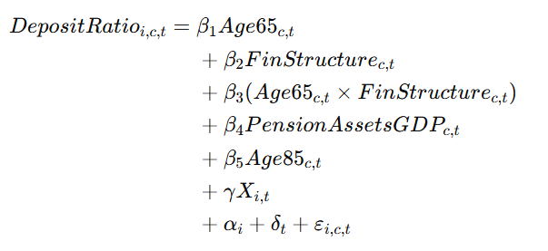
Components of the refined regression model
Regression component
Explanation
Baseline aging effect
Financial system structure effect
Aging effect depending on structure (interaction term)
Explanation on next slide why pension system should not be main explanatory variable
Pension system control variable
Very old population effect
Bank-level control variables (see next slides)
Bank & year fixed effects; error term

Slide 10
Financial system structure as the key explanatory mechanism
Pension system structure
Financial system structure
Key question
How much wealth needs to be accumulated for retirement?
Once wealth is accumulated, where are these savings allocated?
→ Affects and determines wealth accumulation
→ Determines if savings go to banks or markets
Mechanism
Determines retirement saving needs
Determines savings intermediation channel
Link to bank deposits
Indirect
Direct
Limitations
Does not determine asset allocation
Only indirectly affects bank deposit levels
Even if we know the levels of wealth accumulation depending on system, we still need to know where this wealth is allocated
Different measures exist
Evolvement of systems over time?

Slide 11
Additional considerations
1
2
Suitable controls from dataset
Pot. omitted variables
Bank size (Large banks rely more on wholesale funding)
GDP development If not controlled, the aging effect may actually capture economic development
Potentially to be controlled for to resolve omitted variable bias
Loan ratio (Banks with more loans need stable funding, which usually comes from deposits)
Interest rate environment Strongly affect deposit attractiveness
Equity ratio (Higher equity = less risk; hence less stable deposit funding needed)
Financial regulation -> Partly absorbed by bank fixed effects
Profitability (Profitable banks attract deposits due to stronger reputation)
Banking structure -> Partly absorbed by bank fixed effects

Slide 12
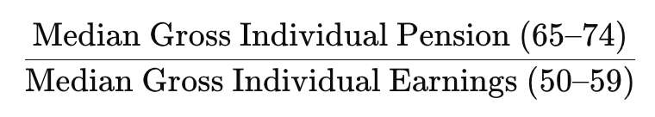
Controlling for pension systems: pension replacement rate
Definition
The aggregate replacement ratio is gross median individual pension income of the population aged 65–74 relative to gross median individual earnings from work of the population aged 55–64, excluding other social benefits
Formula
Datasets
European Union: 2014-2025
https://ec.europa.eu/eurostat/databrowser/view/tespm100__custom_20473233/default/table
OECD 2013
https://www.oecd.org/content/dam/oecd/en/publications/reports/2013/11/pensions-at-a-glance-2013_g1g3404e/pension_glance-2013-en.pdf
OECD 2012
https://www.oecd.org/content/dam/oecd/en/publications/reports/2012/06/oecd-pensions-outlook-2012_g1g1aeb6/9789264169401-en.pdf
OECD 2011
https://www.oecd.org/content/dam/oecd/en/publications/reports/2011/03/pensions-at-a-glance-2011_g1g12126/pension_glance-2011-en.pdf
OECD 2009
https://www.oecd.org/content/dam/oecd/en/publications/reports/2009/09/pensions-at-a-glance-2009_g1ghab79/pension_glance-2009-en.pdf

Slide 13
Separating “where” and “how much”
Discussion
Pension system
Key question
How much wealth needs to be accumulated for retirement?
How much wealth needs to be accumulated for retirement given public “generosity”
→ Affects and determines wealth accumulation
→ Affects and determines wealth accumulation
Mechanism
Determines retirement saving needs
Determines retirement saving needs
Link to bank deposits
Indirect
Indirect
Measures
Pension Assets / GDP
Replacement Ratio
Limitations
Proxies the observable stock of funded retirement wealth in the economy
Reflects the outcome of asset allocation, not just retirement saving incentives
Multicollinearity threat (can move with broader financial development)
Proxies how much households need to save privately for retirement.
Is closer to the underlying saving incentive
Helps separate how much households need to save from where those savings are held
Depending on focus might be harder to get (clean data for EU 2014-2025)

Slide 14
Motivation (TBD)
Motivation
Lifecycle theory (Modigliani and Brumberg, 1954): As households age, loan demand falls while demand for safe retirement assets rises, implying that aging can increase deposit-type savings and reduce borrowing
XXX Bank vs Market
Motivation
Lifecycle theory (Modigliani and Brumberg, 1954): As households age, loan demand falls while demand for safe retirement assets rises, implying that aging can increase deposit-type savings and reduce borrowing
XXX

Slide 15
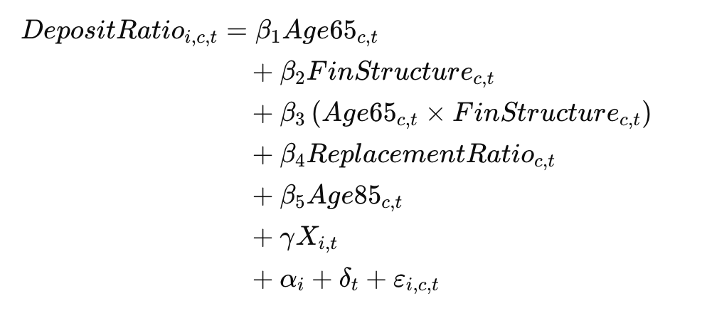
Revised: components of the refined regression model
Discussion
Regression component
Explanation
Baseline aging effect
Financial system structure effect
Aging effect depending on structure (interaction term)
Revised variable
Pension system control variable
Very old population effect
Bank-level control variables (see next slides)
Bank & year fixed effects; error term

